Slide 1

Pierce college master plan planning commission
November 10, 2021
FIRST PAGE
GILL SANS MT (HEADING) 44
GILL SANS MT (BODY) 32
SLIDES
GILL SANTS MT (HEADING) 40
GILL SANS MT (BODY) 28-32
FINAL SLIDE
GILL SANS MT (HEADING) 40-44
Design → Variants → Colors → Median
Case ID: P-21-0049

Slide 2
P-21-0046 PIERCE COLLEGE MASTER PLAN
Proposed project:
Update to the College campus master plan
Master Plans authorized by PMC 20.88
City Council approval, with Planning Commission recommendation

Slide 3
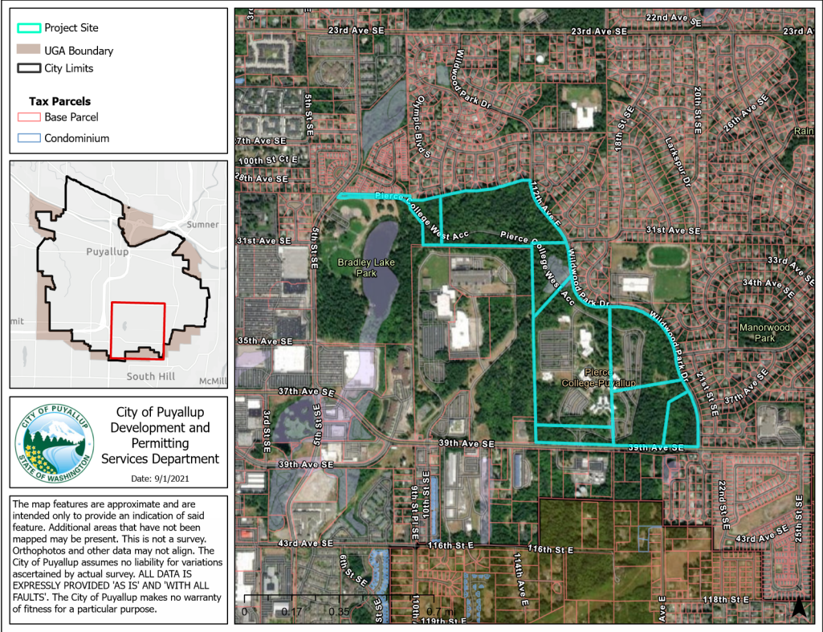
VICINITY MAP

Slide 4
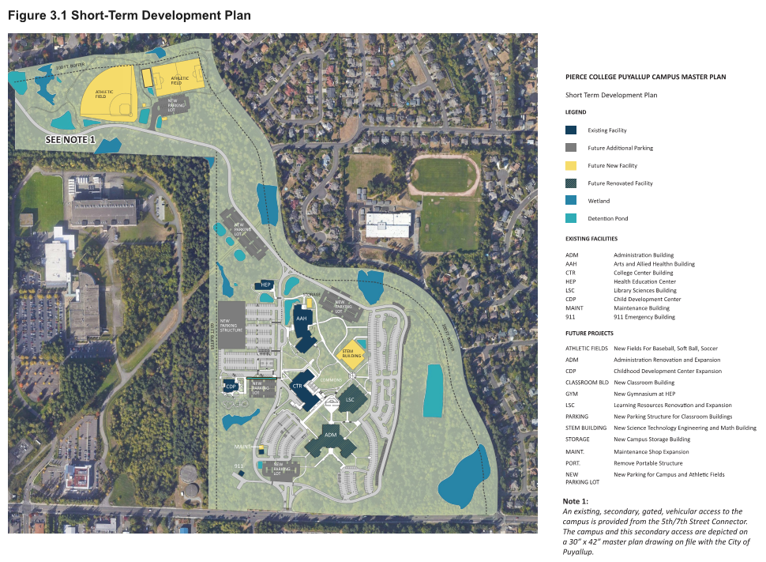

Slide 5
P-21-0046 PIERCE COLLEGE MASTER PLAN
Key application information:
Applicant: Pierce College
    (McGranahan Architects, AHBL – applicant representatives)
Site: 1601 39th Ave SE
Zoning: Public Facilities (PF)
Land Use: PF
Environment
Review(SEPA): SEPA checklist submitted, under
review. Puyallup: Lead Agency

Slide 6
P-21-0046 PIERCE COLLEGE MASTER PLAN
Key application timeline
Proposal submitted: May 12, 2021*
  *Application incomplete
Neighborhood mtg.: August 04, 2021
Notice of application: Sept. 07, 2021
Development Review:
  Review letter: October 15, 2021

Slide 7
P-21-0046 PIERCE COLLEGE MASTER PLAN
Review criteria (PMC 19.08.030):
Hearing Examiner to consider - Is the proposal:
Is the public interest will be served by approval of the subdivision?
Does the development meet public health and safety standards and provide for appropriate features needed to serve the homes proposed?
Drainage management, street design, sidewalks, street lighting, water, sewer, impacts on public facilities, safety, health, general welfare – are these addressed?
Key public comment themes:
Concerns regarding athletic fields – lighting, parking impacts - access to the fields through neighborhoods to north & Wildwood Park Drive, noise
Impacts to residential neighborhoods near Bradley Park – request for additional drive access onto Wildwood Park Drive

Slide 8
P-21-0046 PIERCE COLLEGE MASTER PLAN
Review criteria (PMC 19.08.030):
Hearing Examiner to consider - Is the proposal:
Is the public interest will be served by approval of the subdivision?
Does the development meet public health and safety standards and provide for appropriate features needed to serve the homes proposed?
Drainage management, street design, sidewalks, street lighting, water, sewer, impacts on public facilities, safety, health, general welfare – are these addressed?
Key public comment themes:
Traffic impact concerns
School district request for walking access improvements on Wildwood and improvements at 31st and Wildwood Drive
Puyallup Tribal request for a cultural resource assessment
Standard Ecology comment letter SEPA (solid waste mgmt., toxic clean ups, water quality, etc)

Slide 9

P-21-0046 PIERCE COLLEGE MASTER PLAN
Development Review Team letter:
10-year/20-year build out site plan
Traffic report – new data collection and analysis
Consistency with South Hill Neighborhood Plan
Use of athletic fields, assessment of impacts
Off-street parking
Consistency with Safe Routes to Schools Plan

Slide 10
P-21-0046 PIERCE COLLEGE MASTER PLAN
Development Review Team letter:
Trail connectivity thru campus to Bradley Park
Street improvements – Wildwood Park drive
Access improvements – College Way Drive
Architectural design standards
Coordination with Pierce Transit (future Bus Rapid Transit)

Slide 11
P-21-0046 PIERCE COLLEGE MASTER PLAN
Review criteria (PMC 19.08.030):
Hearing Examiner to consider - Is the proposal:
Is the public interest will be served by approval of the subdivision?
Does the development meet public health and safety standards and provide for appropriate features needed to serve the homes proposed?
Drainage management, street design, sidewalks, street lighting, water, sewer, impacts on public facilities, safety, health, general welfare – are these addressed?
Next steps:
Applicant response to city staff, resubmittal
City and College coordination on overall schedule
  College resub (Q4, 2021 – Q1, 2022)
  Additional PC briefing (Q1, 2022)
  PC Public Hearing (Q1, 2022) – recommendation to Council
  Council review and adoption (Q2 2022)

Slide 12
Pierce college master plan planning commission
November 10, 2021
FIRST PAGE
GILL SANS MT (HEADING) 44
GILL SANS MT (BODY) 32
SLIDES
GILL SANTS MT (HEADING) 40
GILL SANS MT (BODY) 28-32
FINAL SLIDE
GILL SANS MT (HEADING) 40-44
Design → Variants → Colors → Median
Case ID: P-21-0049

